Slide 1
P3-v5.4.4
HRDPS validation in GEM5.3.10-a10 and PA3a configuration
Full3mom (only winter 2022)

Slide 2
Objective and set-up
To test latest P3 version (full3mom; Morrison et al., 2025)
Experimental set-up
GEM 5.3.0-a10, HRDPS PA3a configuration for 40 cases winter 2022
Note: v5.3.14 is not the good control, since that version includes HM changes.
I did an error here, but results are consistent with v5.3.14 vs. v5.3.13.
The comparison between the 2 3M versions is what is interesting here.
Experiment | Description | Control
P3v5.4.4 | 2MOM_noLF_n1 | P3v.5.3.14
P3v5.4.4LF3M (old) | 3MOMold_LF_n1 | P3v.5.3.14LF3M
P3v5.4.4LF3M | full3MOM_LF_n1 | P3v5.4.4LF3M (old)

Slide 3
V5.4.4 vs. v5.3.14

Slide 4
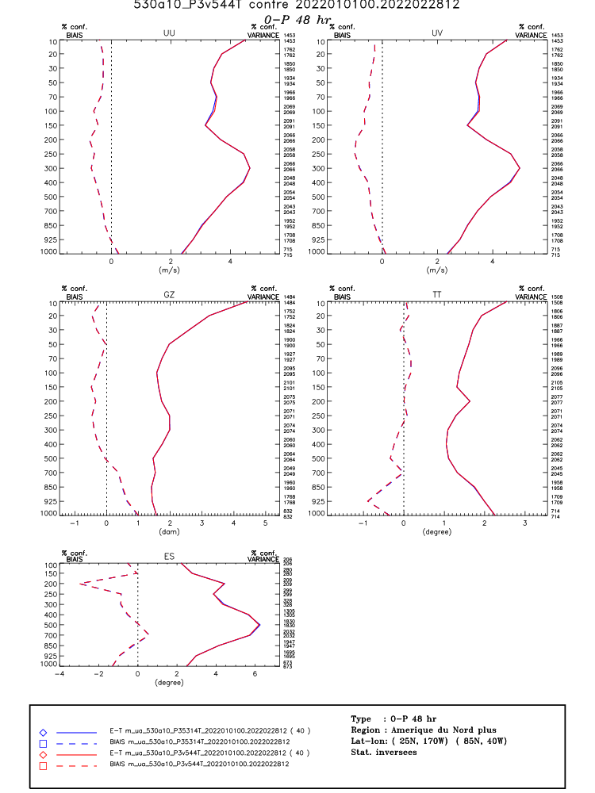
Scores v5.3.14 vs. 5.4.4
Arcad → completely neutral

Slide 5
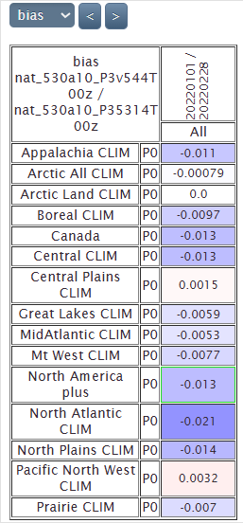
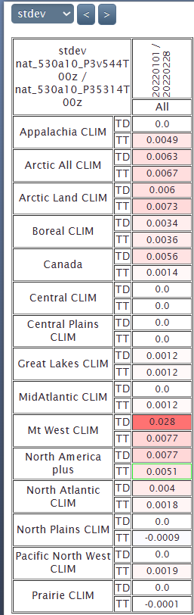
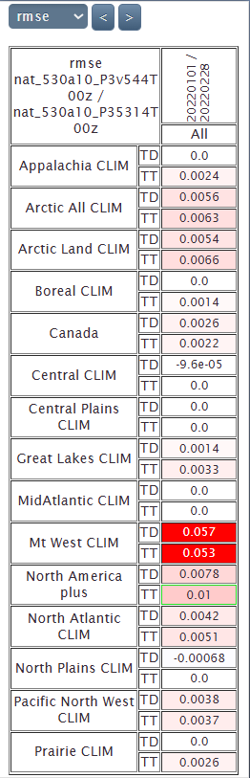
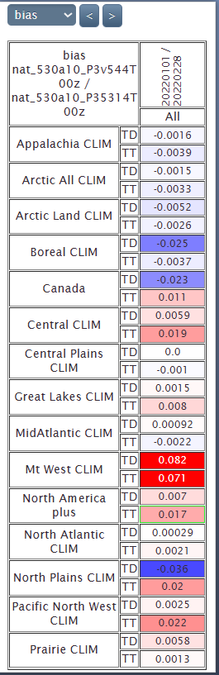
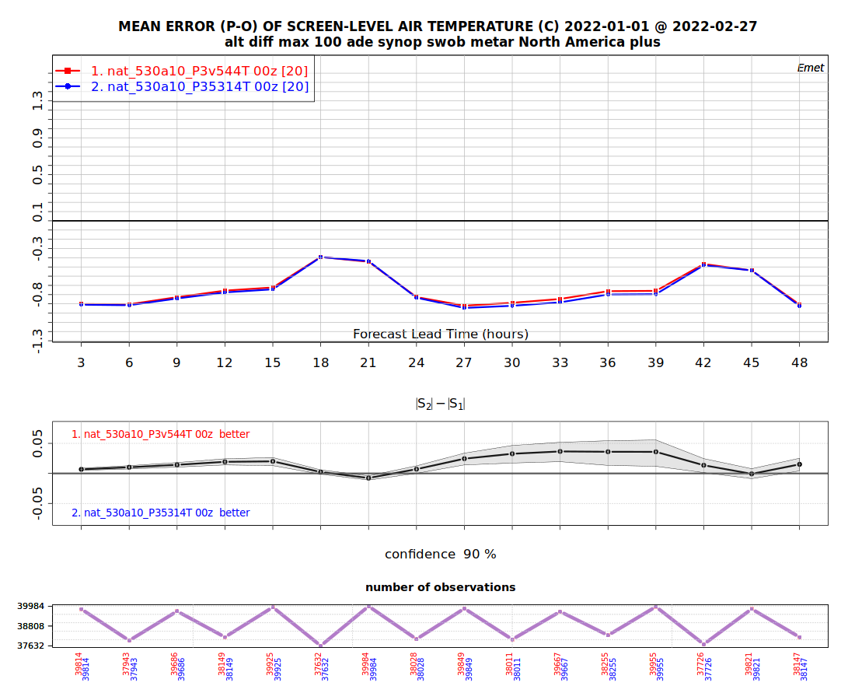
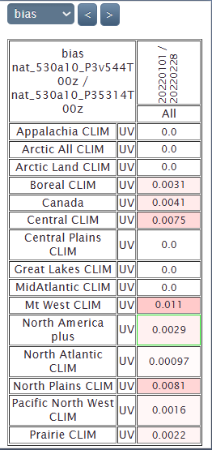
Scores v5.3.14 vs. 5.4.4
Normal since v5.4.4 does not include HM changes for FZ.
Emet TT, TD, UV, P0
Very small differences

Slide 6
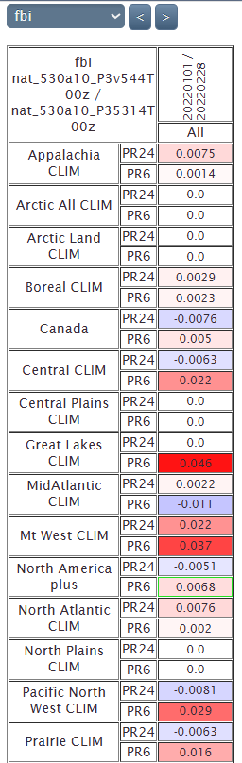
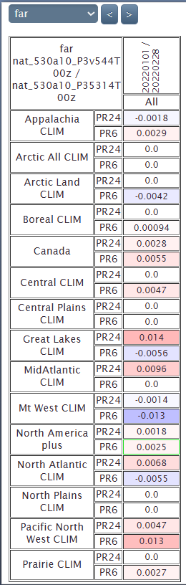
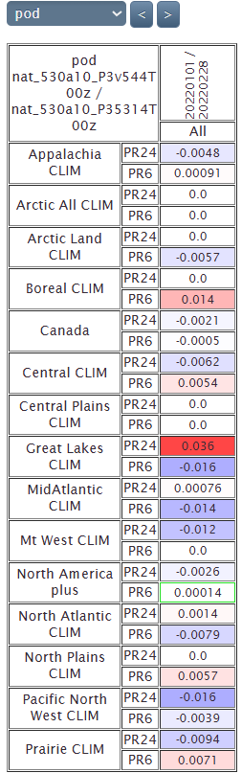
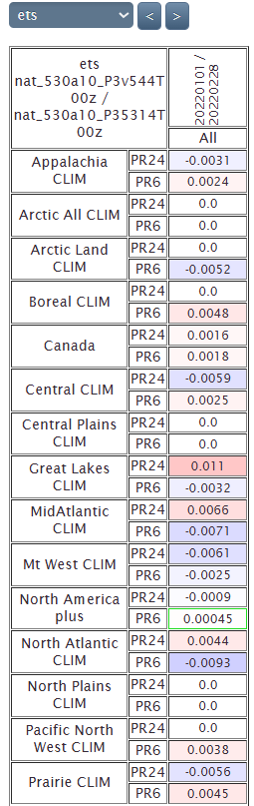
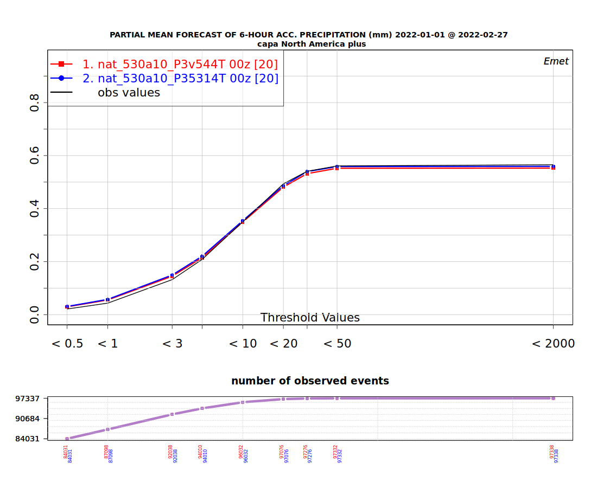
Scores v5.3.14 vs. v5.4.4
Emet (PR6 and PR24)

Slide 7
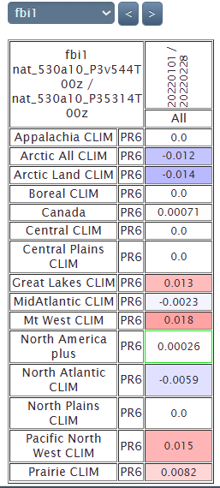
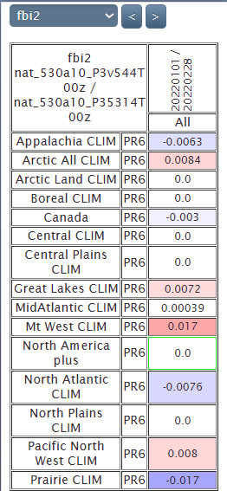
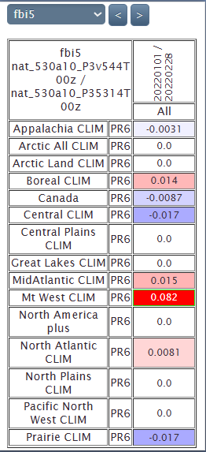
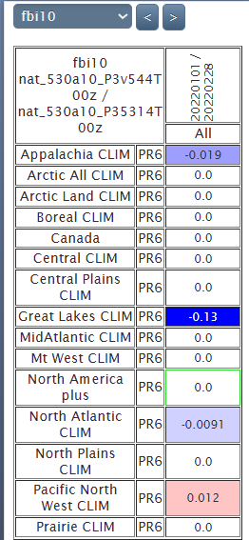
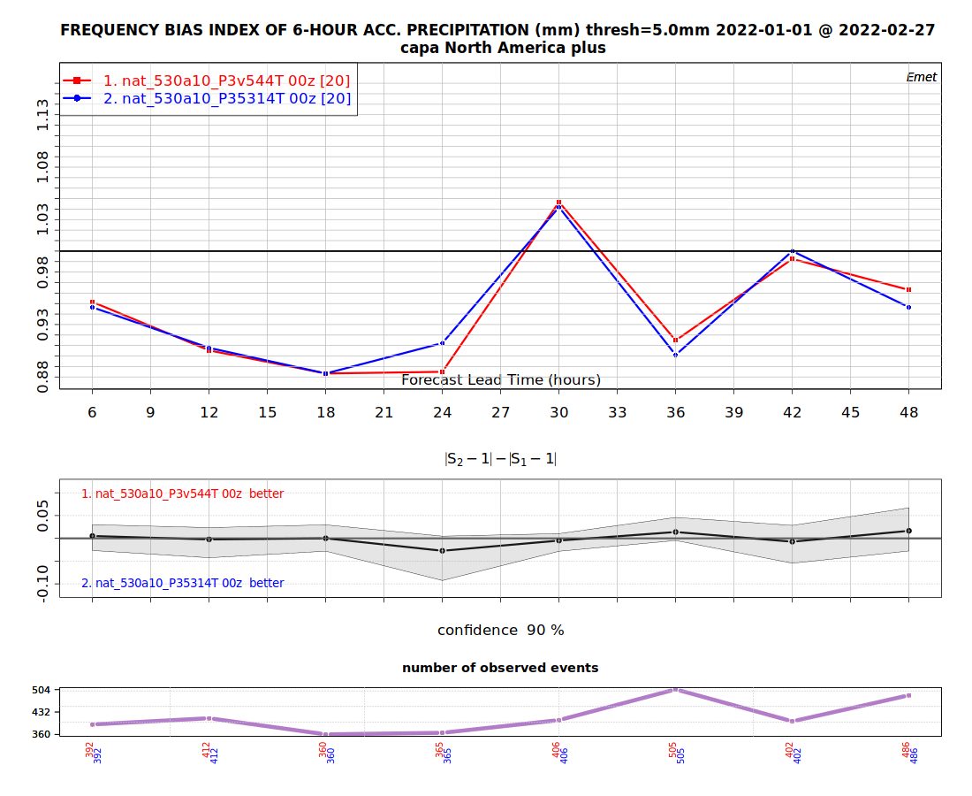
Scores v5.3.14 vs. v5.4.4
Did not really worked…
FBI

Slide 8
Timing v5.3.14
HRnat_530a10_P35314T_2022010100_M_4566858.sc6pbs-001-ib.out.000:oe-00000-00000: Execution time : 5539.1469 seconds (13.40 ms logging)
HRnat_530a10_P35314T_2022010212_M_4566863.sc6pbs-001-ib.out.000:oe-00000-00000: Execution time : 5702.7311 seconds (13.34 ms logging)
HRnat_530a10_P35314T_2022010400_M_4566848.sc6pbs-001-ib.out.000:oe-00000-00000: Execution time : 5565.9317 seconds (13.51 ms logging)
HRnat_530a10_P35314T_2022010512_M_4566861.sc6pbs-001-ib.out.000:oe-00000-00000: Execution time : 5529.9992 seconds (13.77 ms logging)
HRnat_530a10_P35314T_2022010700_M_4566868.sc6pbs-001-ib.out.000:oe-00000-00000: Execution time : 5614.4304 seconds (13.36 ms logging)
HRnat_530a10_P35314T_2022010812_M_4566854.sc6pbs-001-ib.out.000:oe-00000-00000: Execution time : 5463.8206 seconds (13.35 ms logging)
HRnat_530a10_P35314T_2022011000_M_4566871.sc6pbs-001-ib.out.000:oe-00000-00000: Execution time : 5467.2939 seconds (13.76 ms logging)
HRnat_530a10_P35314T_2022011112_M_4566884.sc6pbs-001-ib.out.000:oe-00000-00000: Execution time : 5404.6790 seconds (13.60 ms logging)
HRnat_530a10_P35314T_2022011300_M_4566870.sc6pbs-001-ib.out.000:oe-00000-00000: Execution time : 5451.0425 seconds (13.65 ms logging)
HRnat_530a10_P35314T_2022011412_M_4566886.sc6pbs-001-ib.out.000:oe-00000-00000: Execution time : 5521.4016 seconds (13.53 ms logging)
HRnat_530a10_P35314T_2022011600_M_4566853.sc6pbs-001-ib.out.000:oe-00000-00000: Execution time : 5483.7060 seconds (13.37 ms logging)
HRnat_530a10_P35314T_2022011712_M_4566879.sc6pbs-001-ib.out.000:oe-00000-00000: Execution time : 5568.0553 seconds (13.68 ms logging)
HRnat_530a10_P35314T_2022011900_M_4566857.sc6pbs-001-ib.out.000:oe-00000-00000: Execution time : 5510.3228 seconds (13.73 ms logging)
HRnat_530a10_P35314T_2022012012_M_4566852.sc6pbs-001-ib.out.000:oe-00000-00000: Execution time : 5493.3345 seconds (13.47 ms logging)
HRnat_530a10_P35314T_2022012200_M_4566873.sc6pbs-001-ib.out.000:oe-00000-00000: Execution time : 5494.0376 seconds (13.86 ms logging)
HRnat_530a10_P35314T_2022012312_M_4566880.sc6pbs-001-ib.out.000:oe-00000-00000: Execution time : 5369.3044 seconds (13.58 ms logging)
HRnat_530a10_P35314T_2022012500_M_4566867.sc6pbs-001-ib.out.000:oe-00000-00000: Execution time : 5350.7144 seconds (13.64 ms logging)
HRnat_530a10_P35314T_2022012612_M_4566865.sc6pbs-001-ib.out.000:oe-00000-00000: Execution time : 5407.6152 seconds (13.32 ms logging)
HRnat_530a10_P35314T_2022012800_M_4566843.sc6pbs-001-ib.out.000:oe-00000-00000: Execution time : 5544.9767 seconds (13.49 ms logging)
HRnat_530a10_P35314T_2022012912_M_4566889.sc6pbs-001-ib.out.000:oe-00000-00000: Execution time : 5698.5934 seconds (13.54 ms logging)
HRnat_530a10_P35314T_2022013100_M_4567187.sc6pbs-001-ib.out.000:oe-00000-00000: Execution time : 5336.5137 seconds (13.43 ms logging)
HRnat_530a10_P35314T_2022020112_M_4567189.sc6pbs-001-ib.out.000:oe-00000-00000: Execution time : 5386.7856 seconds (13.54 ms logging)
HRnat_530a10_P35314T_2022020300_M_4567190.sc6pbs-001-ib.out.000:oe-00000-00000: Execution time : 5422.8279 seconds (13.71 ms logging)
HRnat_530a10_P35314T_2022020412_M_4567191.sc6pbs-001-ib.out.000:oe-00000-00000: Execution time : 5467.3502 seconds (13.36 ms logging)
HRnat_530a10_P35314T_2022020600_M_4567188.sc6pbs-001-ib.out.000:oe-00000-00000: Execution time : 5446.0372 seconds (13.54 ms logging)
HRnat_530a10_P35314T_2022020712_M_4567211.sc6pbs-001-ib.out.000:oe-00000-00000: Execution time : 5450.2427 seconds (13.87 ms logging)
HRnat_530a10_P35314T_2022020900_M_4567217.sc6pbs-001-ib.out.000:oe-00000-00000: Execution time : 5533.1442 seconds (13.42 ms logging)
HRnat_530a10_P35314T_2022021012_M_4567227.sc6pbs-001-ib.out.000:oe-00000-00000: Execution time : 5375.1154 seconds (14.82 ms logging)
HRnat_530a10_P35314T_2022021200_M_4567230.sc6pbs-001-ib.out.000:oe-00000-00000: Execution time : 5374.6365 seconds (13.83 ms logging)
HRnat_530a10_P35314T_2022021312_M_4567232.sc6pbs-001-ib.out.000:oe-00000-00000: Execution time : 5516.7504 seconds (13.34 ms logging)
HRnat_530a10_P35314T_2022021500_M_4567255.sc6pbs-001-ib.out.000:oe-00000-00000: Execution time : 5363.8138 seconds (13.64 ms logging)
HRnat_530a10_P35314T_2022021612_M_4567265.sc6pbs-001-ib.out.000:oe-00000-00000: Execution time : 5469.9788 seconds (13.62 ms logging)
HRnat_530a10_P35314T_2022021800_M_4567262.sc6pbs-001-ib.out.000:oe-00000-00000: Execution time : 5617.5971 seconds (13.44 ms logging)
HRnat_530a10_P35314T_2022021912_M_4567258.sc6pbs-001-ib.out.000:oe-00000-00000: Execution time : 5484.5912 seconds (13.66 ms logging)
HRnat_530a10_P35314T_2022022100_M_4567281.sc6pbs-001-ib.out.000:oe-00000-00000: Execution time : 5451.8357 seconds (13.84 ms logging)
HRnat_530a10_P35314T_2022022212_M_4567282.sc6pbs-001-ib.out.000:oe-00000-00000: Execution time : 5471.1615 seconds (13.66 ms logging)
HRnat_530a10_P35314T_2022022400_M_4567298.sc6pbs-001-ib.out.000:oe-00000-00000: Execution time : 5460.3636 seconds (13.50 ms logging)
HRnat_530a10_P35314T_2022022512_M_4567306.sc6pbs-001-ib.out.000:oe-00000-00000: Execution time : 5464.0724 seconds (13.66 ms logging)
HRnat_530a10_P35314T_2022022700_M_4567361.sc6pbs-001-ib.out.000:oe-00000-00000: Execution time : 5440.2581 seconds (13.71 ms logging)
HRnat_530a10_P35314T_2022022812_M_4567396.sc6pbs-001-ib.out.000:oe-00000-00000: Execution time : 5517.8689 seconds (13.76 ms logging)
Mean (2MOM_noLF_n1):
219212/40 = 5480 seconds

Slide 9
Timing v5.4.4
HRnat_530a10_P3v544T_2022010100_M_4588483.sc6pbs-001-ib.out.000:oe-00000-00000: Execution time : 5493.9833 seconds (14.06 ms logging)
HRnat_530a10_P3v544T_2022010212_M_4588490.sc6pbs-001-ib.out.000:oe-00000-00000: Execution time : 5699.8247 seconds (13.45 ms logging)
HRnat_530a10_P3v544T_2022010400_M_4588485.sc6pbs-001-ib.out.000:oe-00000-00000: Execution time : 5561.6870 seconds (14.13 ms logging)
HRnat_530a10_P3v544T_2022010512_M_4588496.sc6pbs-001-ib.out.000:oe-00000-00000: Execution time : 5488.7608 seconds (13.55 ms logging)
HRnat_530a10_P3v544T_2022010700_M_4588489.sc6pbs-001-ib.out.000:oe-00000-00000: Execution time : 5635.1995 seconds (13.39 ms logging)
HRnat_530a10_P3v544T_2022010812_M_4588487.sc6pbs-001-ib.out.000:oe-00000-00000: Execution time : 5489.9046 seconds (14.41 ms logging)
HRnat_530a10_P3v544T_2022011000_M_4588495.sc6pbs-001-ib.out.000:oe-00000-00000: Execution time : 5454.6262 seconds (14.10 ms logging)
HRnat_530a10_P3v544T_2022011112_M_4588469.sc6pbs-001-ib.out.000:oe-00000-00000: Execution time : 5412.3345 seconds (13.72 ms logging)
HRnat_530a10_P3v544T_2022011300_M_4588457.sc6pbs-001-ib.out.000:oe-00000-00000: Execution time : 5477.8582 seconds (13.61 ms logging)
HRnat_530a10_P3v544T_2022011412_M_4588480.sc6pbs-001-ib.out.000:oe-00000-00000: Execution time : 5548.3549 seconds (13.91 ms logging)
HRnat_530a10_P3v544T_2022011600_M_4588481.sc6pbs-001-ib.out.000:oe-00000-00000: Execution time : 5508.0072 seconds (13.70 ms logging)
HRnat_530a10_P3v544T_2022011712_M_4588474.sc6pbs-001-ib.out.000:oe-00000-00000: Execution time : 5535.3962 seconds (13.75 ms logging)
HRnat_530a10_P3v544T_2022011900_M_4588455.sc6pbs-001-ib.out.000:oe-00000-00000: Execution time : 5430.4827 seconds (13.80 ms logging)
HRnat_530a10_P3v544T_2022012012_M_4588451.sc6pbs-001-ib.out.000:oe-00000-00000: Execution time : 5489.6011 seconds (13.58 ms logging)
HRnat_530a10_P3v544T_2022012200_M_4588501.sc6pbs-001-ib.out.000:oe-00000-00000: Execution time : 5518.9648 seconds (13.62 ms logging)
HRnat_530a10_P3v544T_2022012312_M_4588461.sc6pbs-001-ib.out.000:oe-00000-00000: Execution time : 5380.0296 seconds (13.85 ms logging)
HRnat_530a10_P3v544T_2022012500_M_4588458.sc6pbs-001-ib.out.000:oe-00000-00000: Execution time : 5359.6829 seconds (13.71 ms logging)
HRnat_530a10_P3v544T_2022012612_M_4588492.sc6pbs-001-ib.out.000:oe-00000-00000: Execution time : 5427.6045 seconds (13.72 ms logging)
HRnat_530a10_P3v544T_2022012800_M_4588505.sc6pbs-001-ib.out.000:oe-00000-00000: Execution time : 5535.2720 seconds (13.66 ms logging)
HRnat_530a10_P3v544T_2022012912_M_4588473.sc6pbs-001-ib.out.000:oe-00000-00000: Execution time : 5651.6626 seconds (13.61 ms logging)
HRnat_530a10_P3v544T_2022013100_M_4589703.sc6pbs-001-ib.out.000:oe-00000-00000: Execution time : 5341.2805 seconds (13.88 ms logging)
HRnat_530a10_P3v544T_2022020112_M_4589700.sc6pbs-001-ib.out.000:oe-00000-00000: Execution time : 5391.6758 seconds (13.77 ms logging)
HRnat_530a10_P3v544T_2022020300_M_4589701.sc6pbs-001-ib.out.000:oe-00000-00000: Execution time : 5503.1782 seconds (13.80 ms logging)
HRnat_530a10_P3v544T_2022020412_M_4589706.sc6pbs-001-ib.out.000:oe-00000-00000: Execution time : 5548.2258 seconds (13.62 ms logging)
HRnat_530a10_P3v544T_2022020600_M_4589726.sc6pbs-001-ib.out.000:oe-00000-00000: Execution time : 5469.4676 seconds (13.50 ms logging)
HRnat_530a10_P3v544T_2022020712_M_4589735.sc6pbs-001-ib.out.000:oe-00000-00000: Execution time : 5476.7799 seconds (14.06 ms logging)
HRnat_530a10_P3v544T_2022020900_M_4589799.sc6pbs-001-ib.out.000:oe-00000-00000: Execution time : 5540.5209 seconds (13.56 ms logging)
HRnat_530a10_P3v544T_2022021012_M_4589809.sc6pbs-001-ib.out.000:oe-00000-00000: Execution time : 5330.1634 seconds (13.93 ms logging)
HRnat_530a10_P3v544T_2022021200_M_4589810.sc6pbs-001-ib.out.000:oe-00000-00000: Execution time : 5342.9890 seconds (13.79 ms logging)
HRnat_530a10_P3v544T_2022021312_M_4589824.sc6pbs-001-ib.out.000:oe-00000-00000: Execution time : 5499.5536 seconds (13.81 ms logging)
HRnat_530a10_P3v544T_2022021500_M_4589883.sc6pbs-001-ib.out.000:oe-00000-00000: Execution time : 5353.2586 seconds (13.62 ms logging)
HRnat_530a10_P3v544T_2022021612_M_4589938.sc6pbs-001-ib.out.000:oe-00000-00000: Execution time : 5463.3153 seconds (13.49 ms logging)
HRnat_530a10_P3v544T_2022021800_M_4590098.sc6pbs-001-ib.out.000:oe-00000-00000: Execution time : 5541.1893 seconds (13.45 ms logging)
HRnat_530a10_P3v544T_2022021912_M_4590118.sc6pbs-001-ib.out.000:oe-00000-00000: Execution time : 5438.6052 seconds (13.58 ms logging)
HRnat_530a10_P3v544T_2022022100_M_4590115.sc6pbs-001-ib.out.000:oe-00000-00000: Execution time : 5332.9844 seconds (13.81 ms logging)
HRnat_530a10_P3v544T_2022022212_M_4590124.sc6pbs-001-ib.out.000:oe-00000-00000: Execution time : 5453.8054 seconds (14.10 ms logging)
HRnat_530a10_P3v544T_2022022400_M_4590125.sc6pbs-001-ib.out.000:oe-00000-00000: Execution time : 5465.9862 seconds (13.41 ms logging)
HRnat_530a10_P3v544T_2022022512_M_4590122.sc6pbs-001-ib.out.000:oe-00000-00000: Execution time : 5452.2713 seconds (14.24 ms logging)
HRnat_530a10_P3v544T_2022022700_M_4590197.sc6pbs-001-ib.out.000:oe-00000-00000: Execution time : 5393.9614 seconds (13.39 ms logging)
HRnat_530a10_P3v544T_2022022812_M_4590224.sc6pbs-001-ib.out.000:oe-00000-00000: Execution time : 5443.6396 seconds (13.77 ms logging)
Mean (2MOM_noLF_n1):
218860/40 = 5471 seconds (-0.16%)

Slide 10
V5.4.4 3M old vs. v5.3.14 3M old (both LF)

Slide 11
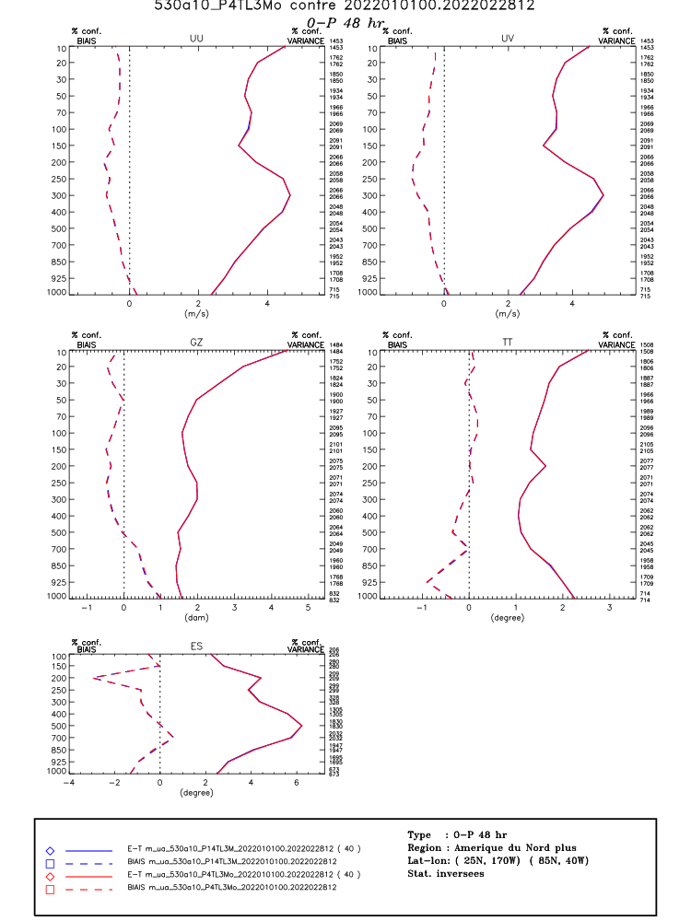
Scores v5.3.143M vs. 5.4.43Mo
Arcad → completely neutral

Slide 12
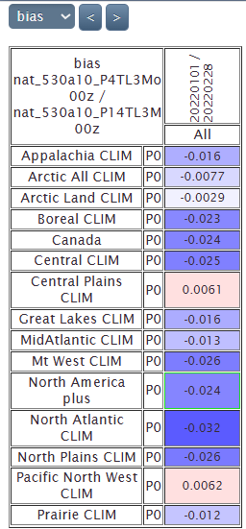
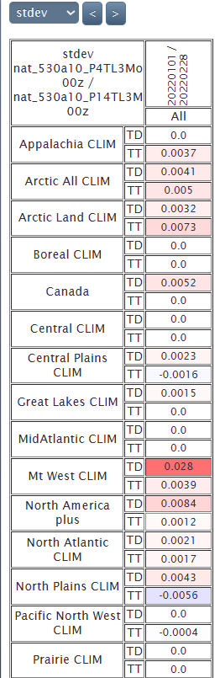
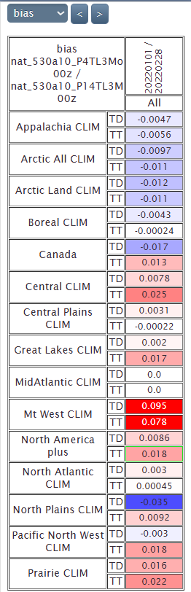

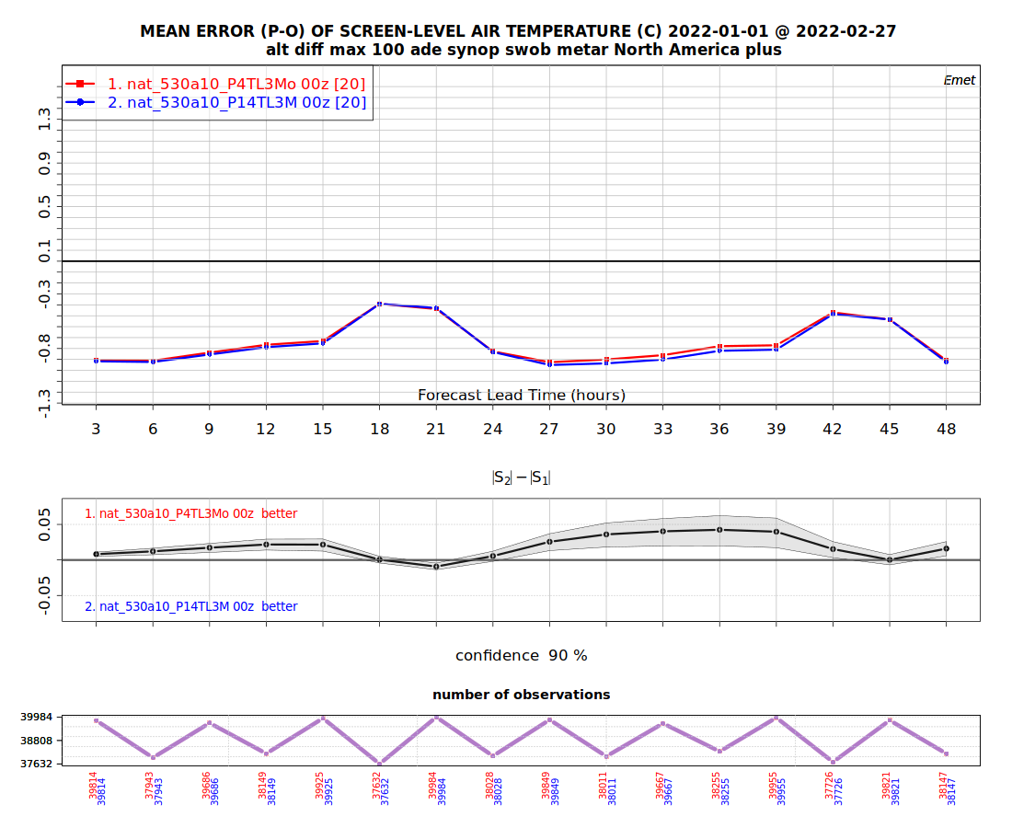
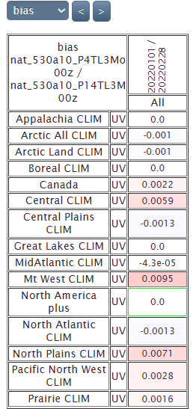
Scores v5.3.143M vs. 5.4.43Mo
Normal since v5.4.4 does not include HM changes for FZ.
Emet TT, TD, UV, P0
Very small differences

Slide 13
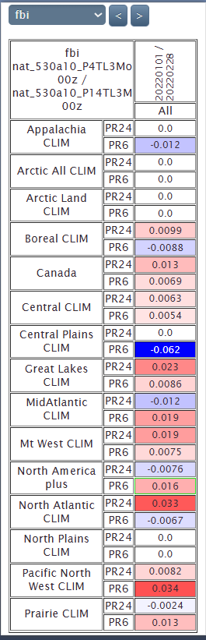
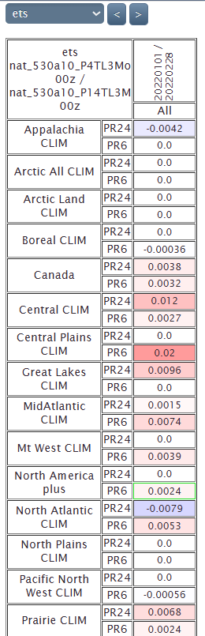
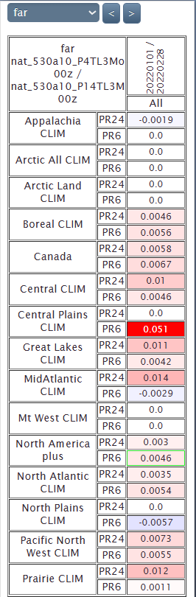
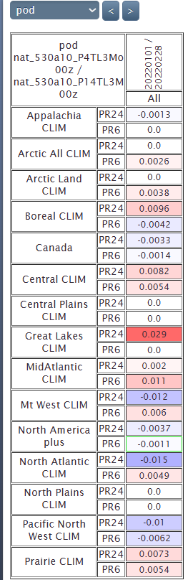
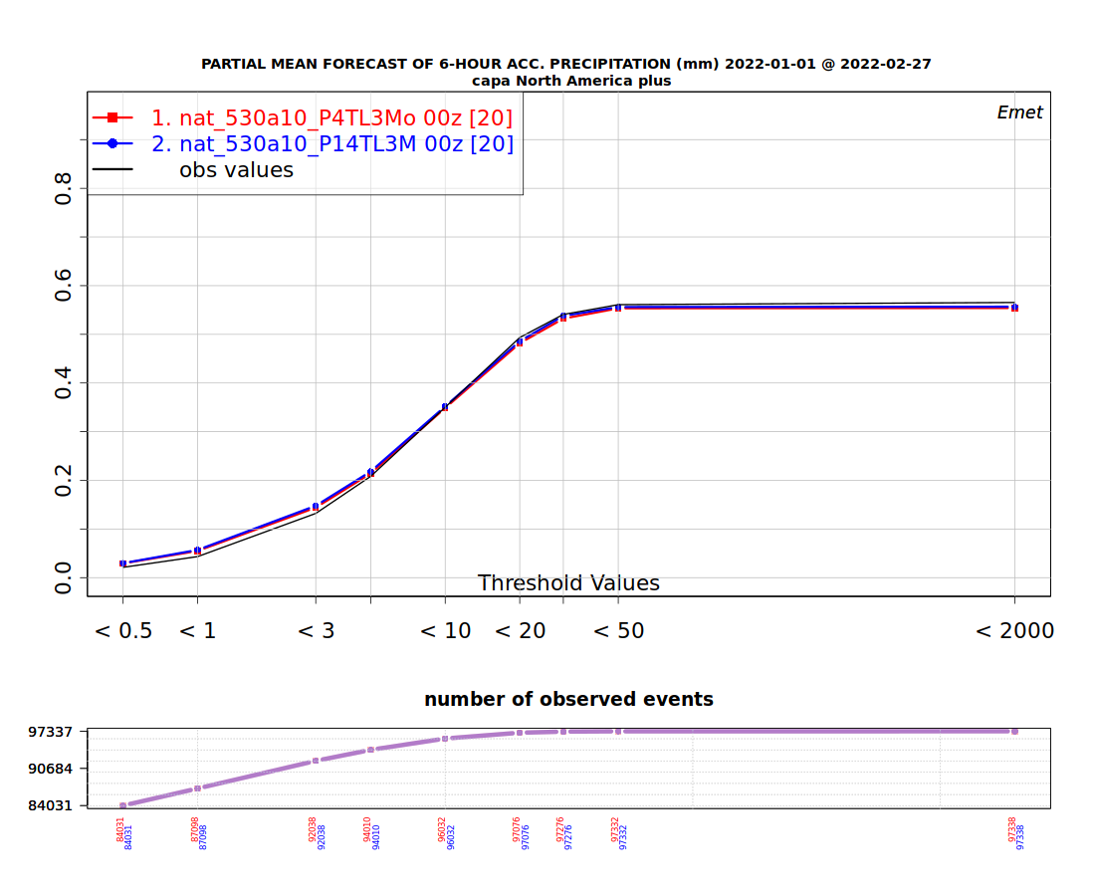
Scores v5.3.143M vs. v5.4.43Mo
Emet (PR6 and PR24)

Slide 14
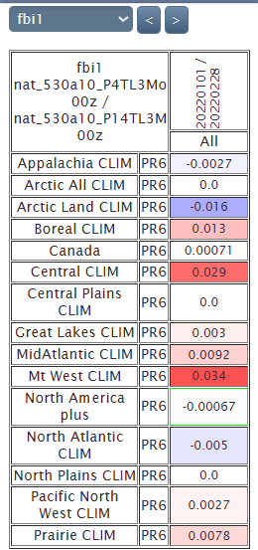
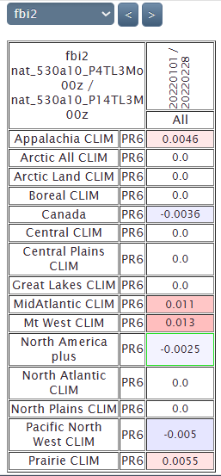
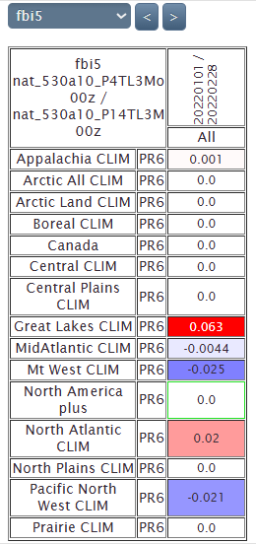
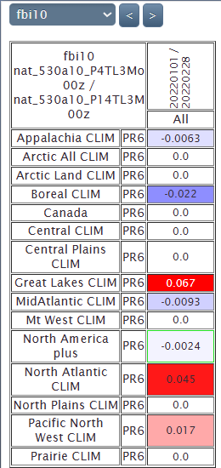
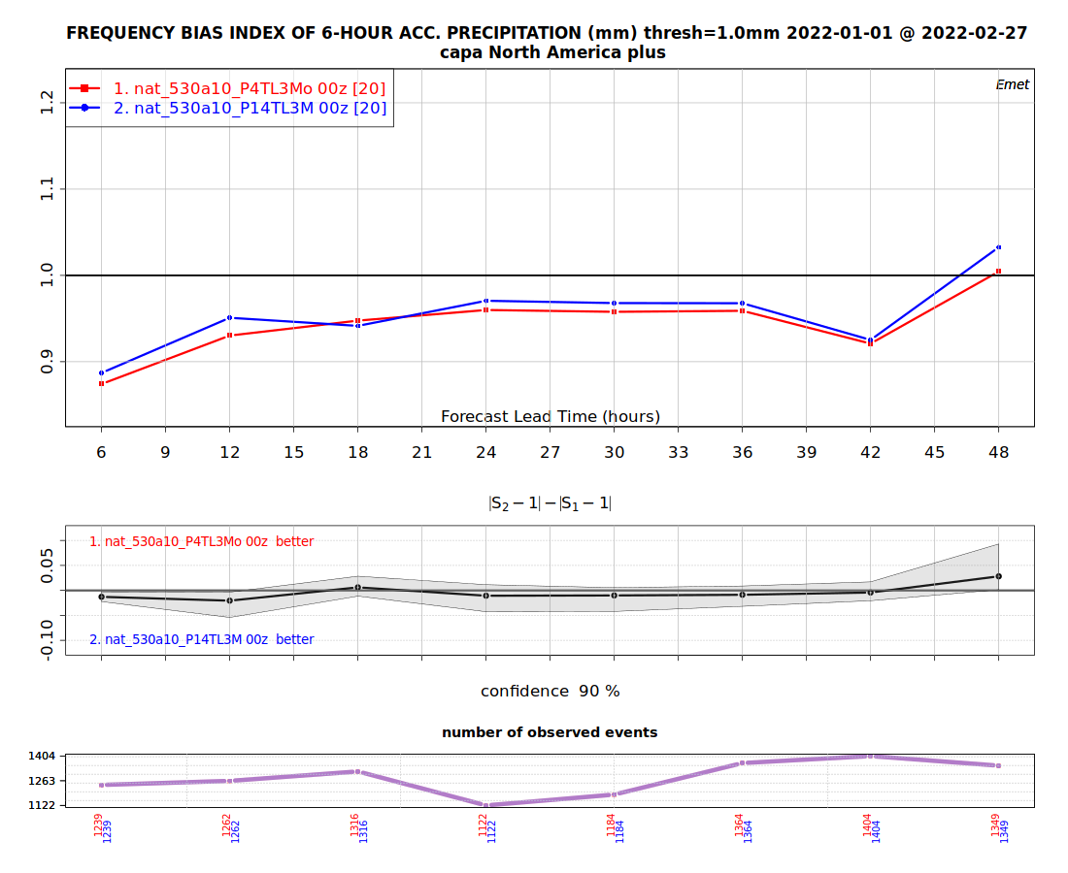
Scores v5.3.143M vs. v5.4.43Mo
FBI

Slide 15
Timing v5.3.14FL3M winter
HRnat_530a10_P14TL3M_2022010100_M_4573033.sc6pbs-001-ib.out.000:oe-00000-00000: Execution time : 6602.8478 seconds (14.09 ms logging)
HRnat_530a10_P14TL3M_2022010212_M_4573059.sc6pbs-001-ib.out.000:oe-00000-00000: Execution time : 7076.1070 seconds (14.16 ms logging)
HRnat_530a10_P14TL3M_2022010400_M_4573036.sc6pbs-001-ib.out.000:oe-00000-00000: Execution time : 6830.1561 seconds (14.30 ms logging)
HRnat_530a10_P14TL3M_2022010512_M_4573058.sc6pbs-001-ib.out.000:oe-00000-00000: Execution time : 6670.1400 seconds (14.21 ms logging)
HRnat_530a10_P14TL3M_2022010700_M_4573057.sc6pbs-001-ib.out.000:oe-00000-00000: Execution time : 6909.7215 seconds (13.92 ms logging)
HRnat_530a10_P14TL3M_2022010812_M_4573054.sc6pbs-001-ib.out.000:oe-00000-00000: Execution time : 6700.1883 seconds (14.07 ms logging)
HRnat_530a10_P14TL3M_2022011000_M_4573056.sc6pbs-001-ib.out.000:oe-00000-00000: Execution time : 6570.0106 seconds (14.01 ms logging)
HRnat_530a10_P14TL3M_2022011112_M_4573061.sc6pbs-001-ib.out.000:oe-00000-00000: Execution time : 6676.4408 seconds (14.08 ms logging)
HRnat_530a10_P14TL3M_2022011300_M_4573065.sc6pbs-001-ib.out.000:oe-00000-00000: Execution time : 6609.2287 seconds (14.58 ms logging)
HRnat_530a10_P14TL3M_2022011412_M_4573069.sc6pbs-001-ib.out.000:oe-00000-00000: Execution time : 6758.3806 seconds (13.86 ms logging)
HRnat_530a10_P14TL3M_2022011600_M_4573067.sc6pbs-001-ib.out.000:oe-00000-00000: Execution time : 6671.1626 seconds (13.80 ms logging)
HRnat_530a10_P14TL3M_2022011712_M_4573072.sc6pbs-001-ib.out.000:oe-00000-00000: Execution time : 7122.0449 seconds (14.16 ms logging)
HRnat_530a10_P14TL3M_2022011900_M_4573068.sc6pbs-001-ib.out.000:oe-00000-00000: Execution time : 6799.9311 seconds (14.24 ms logging)
HRnat_530a10_P14TL3M_2022012012_M_4573071.sc6pbs-001-ib.out.000:oe-00000-00000: Execution time : 6796.2416 seconds (13.88 ms logging)
HRnat_530a10_P14TL3M_2022012200_M_4573073.sc6pbs-001-ib.out.000:oe-00000-00000: Execution time : 6827.7273 seconds (14.28 ms logging)
HRnat_530a10_P14TL3M_2022012312_M_4573035.sc6pbs-001-ib.out.000:oe-00000-00000: Execution time : 6560.3851 seconds (14.05 ms logging)
HRnat_530a10_P14TL3M_2022012500_M_4573062.sc6pbs-001-ib.out.000:oe-00000-00000: Execution time : 6483.3155 seconds (14.22 ms logging)
HRnat_530a10_P14TL3M_2022012612_M_4573060.sc6pbs-001-ib.out.000:oe-00000-00000: Execution time : 6551.4251 seconds (14.70 ms logging)
HRnat_530a10_P14TL3M_2022012800_M_4573066.sc6pbs-001-ib.out.000:oe-00000-00000: Execution time : 6608.6021 seconds (14.31 ms logging)
HRnat_530a10_P14TL3M_2022012912_M_4573063.sc6pbs-001-ib.out.000:oe-00000-00000: Execution time : 7121.2519 seconds (13.89 ms logging)
HRnat_530a10_P14TL3M_2022013100_M_4573920.sc6pbs-001-ib.out.000:oe-00000-00000: Execution time : 6217.8572 seconds (14.07 ms logging)
HRnat_530a10_P14TL3M_2022020112_M_4573921.sc6pbs-001-ib.out.000:oe-00000-00000: Execution time : 6565.1633 seconds (14.12 ms logging)
HRnat_530a10_P14TL3M_2022020300_M_4573925.sc6pbs-001-ib.out.000:oe-00000-00000: Execution time : 6809.6734 seconds (14.05 ms logging)
HRnat_530a10_P14TL3M_2022020412_M_4574066.sc6pbs-001-ib.out.000:oe-00000-00000: Execution time : 6760.8974 seconds (14.07 ms logging)
HRnat_530a10_P14TL3M_2022020600_M_4574067.sc6pbs-001-ib.out.000:oe-00000-00000: Execution time : 6483.3920 seconds (13.95 ms logging)
HRnat_530a10_P14TL3M_2022020712_M_4574124.sc6pbs-001-ib.out.000:oe-00000-00000: Execution time : 6589.7529 seconds (14.17 ms logging)
HRnat_530a10_P14TL3M_2022020900_M_4574128.sc6pbs-001-ib.out.000:oe-00000-00000: Execution time : 6685.1644 seconds (14.19 ms logging)
HRnat_530a10_P14TL3M_2022021012_M_4574159.sc6pbs-001-ib.out.000:oe-00000-00000: Execution time : 6398.4372 seconds (13.91 ms logging)
HRnat_530a10_P14TL3M_2022021200_M_4574140.sc6pbs-001-ib.out.000:oe-00000-00000: Execution time : 6347.3886 seconds (14.29 ms logging)
HRnat_530a10_P14TL3M_2022021312_M_4574152.sc6pbs-001-ib.out.000:oe-00000-00000: Execution time : 6702.8717 seconds (14.07 ms logging)
HRnat_530a10_P14TL3M_2022021500_M_4574166.sc6pbs-001-ib.out.000:oe-00000-00000: Execution time : 6482.4028 seconds (14.27 ms logging)
HRnat_530a10_P14TL3M_2022021612_M_4574190.sc6pbs-001-ib.out.000:oe-00000-00000: Execution time : 6732.6073 seconds (14.54 ms logging)
HRnat_530a10_P14TL3M_2022021800_M_4574193.sc6pbs-001-ib.out.000:oe-00000-00000: Execution time : 6636.8613 seconds (13.84 ms logging)
HRnat_530a10_P14TL3M_2022021912_M_4574207.sc6pbs-001-ib.out.000:oe-00000-00000: Execution time : 6496.5478 seconds (14.01 ms logging)
HRnat_530a10_P14TL3M_2022022100_M_4574205.sc6pbs-001-ib.out.000:oe-00000-00000: Execution time : 6493.8271 seconds (14.00 ms logging)
HRnat_530a10_P14TL3M_2022022212_M_4574216.sc6pbs-001-ib.out.000:oe-00000-00000: Execution time : 6819.2784 seconds (14.23 ms logging)
HRnat_530a10_P14TL3M_2022022400_M_4574241.sc6pbs-001-ib.out.000:oe-00000-00000: Execution time : 6810.6079 seconds (13.93 ms logging)
HRnat_530a10_P14TL3M_2022022512_M_4574272.sc6pbs-001-ib.out.000:oe-00000-00000: Execution time : 6536.6468 seconds (14.25 ms logging)
HRnat_530a10_P14TL3M_2022022700_M_4574278.sc6pbs-001-ib.out.000:oe-00000-00000: Execution time : 6362.7212 seconds (13.99 ms logging)
HRnat_530a10_P14TL3M_2022022812_M_4574295.sc6pbs-001-ib.out.000:oe-00000-00000: Execution time : 6454.1240 seconds (13.99 ms logging)
Mean (3MOM_LF_n1):
259951/40 = 6498 seconds (+14%)

Slide 16
Timing v5.4.4FL3Mo winter
HRnat_530a10_P4TL3Mo_2022010100_M_4595116.sc6pbs-001-ib.out.000:oe-00000-00000: Execution time : 7148.4058 seconds (14.52 ms logging)
HRnat_530a10_P4TL3Mo_2022010212_M_4595115.sc6pbs-001-ib.out.000:oe-00000-00000: Execution time : 7554.7858 seconds (14.12 ms logging)
HRnat_530a10_P4TL3Mo_2022010400_M_4595101.sc6pbs-001-ib.out.000:oe-00000-00000: Execution time : 7474.0948 seconds (14.38 ms logging)
HRnat_530a10_P4TL3Mo_2022010512_M_4595123.sc6pbs-001-ib.out.000:oe-00000-00000: Execution time : 7239.2990 seconds (14.37 ms logging)
HRnat_530a10_P4TL3Mo_2022010700_M_4595133.sc6pbs-001-ib.out.000:oe-00000-00000: Execution time : 7408.5748 seconds (14.01 ms logging)
HRnat_530a10_P4TL3Mo_2022010812_M_4595113.sc6pbs-001-ib.out.000:oe-00000-00000: Execution time : 7287.7729 seconds (14.57 ms logging)
HRnat_530a10_P4TL3Mo_2022011000_M_4595119.sc6pbs-001-ib.out.000:oe-00000-00000: Execution time : 7081.6171 seconds (13.68 ms logging)
HRnat_530a10_P4TL3Mo_2022011112_M_4595132.sc6pbs-001-ib.out.000:oe-00000-00000: Execution time : 7090.2209 seconds (14.30 ms logging)
HRnat_530a10_P4TL3Mo_2022011300_M_4595129.sc6pbs-001-ib.out.000:oe-00000-00000: Execution time : 7097.2246 seconds (14.80 ms logging)
HRnat_530a10_P4TL3Mo_2022011412_M_4595104.sc6pbs-001-ib.out.000:oe-00000-00000: Execution time : 7307.7766 seconds (14.20 ms logging)
HRnat_530a10_P4TL3Mo_2022011600_M_4595130.sc6pbs-001-ib.out.000:oe-00000-00000: Execution time : 7245.5846 seconds (14.62 ms logging)
HRnat_530a10_P4TL3Mo_2022011712_M_4595131.sc6pbs-001-ib.out.000:oe-00000-00000: Execution time : 7620.5671 seconds (14.02 ms logging)
HRnat_530a10_P4TL3Mo_2022011900_M_4595120.sc6pbs-001-ib.out.000:oe-00000-00000: Execution time : 7288.2555 seconds (14.28 ms logging)
HRnat_530a10_P4TL3Mo_2022012012_M_4595139.sc6pbs-001-ib.out.000:oe-00000-00000: Execution time : 7306.1197 seconds (14.34 ms logging)
HRnat_530a10_P4TL3Mo_2022012200_M_4595117.sc6pbs-001-ib.out.000:oe-00000-00000: Execution time : 7372.9733 seconds (14.08 ms logging)
HRnat_530a10_P4TL3Mo_2022012312_M_4595127.sc6pbs-001-ib.out.000:oe-00000-00000: Execution time : 6999.5063 seconds (14.11 ms logging)
HRnat_530a10_P4TL3Mo_2022012500_M_4595128.sc6pbs-001-ib.out.000:oe-00000-00000: Execution time : 6905.6225 seconds (14.04 ms logging)
HRnat_530a10_P4TL3Mo_2022012612_M_4595143.sc6pbs-001-ib.out.000:oe-00000-00000: Execution time : 7028.9002 seconds (14.46 ms logging)
HRnat_530a10_P4TL3Mo_2022012800_M_4595109.sc6pbs-001-ib.out.000:oe-00000-00000: Execution time : 7086.4850 seconds (14.08 ms logging)
HRnat_530a10_P4TL3Mo_2022012912_M_4595140.sc6pbs-001-ib.out.000:oe-00000-00000: Execution time : 7618.0720 seconds (14.16 ms logging)
HRnat_530a10_P4TL3Mo_2022013100_M_4596608.sc6pbs-001-ib.out.000:oe-00000-00000: Execution time : 6585.1411 seconds (14.57 ms logging)
HRnat_530a10_P4TL3Mo_2022020112_M_4596617.sc6pbs-001-ib.out.000:oe-00000-00000: Execution time : 7127.4772 seconds (14.13 ms logging)
HRnat_530a10_P4TL3Mo_2022020300_M_4596655.sc6pbs-001-ib.out.000:oe-00000-00000: Execution time : 7815.4916 seconds (13.75 ms logging)
HRnat_530a10_P4TL3Mo_2022020412_M_4596725.sc6pbs-001-ib.out.000:oe-00000-00000: Execution time : 7651.4572 seconds (14.49 ms logging)
HRnat_530a10_P4TL3Mo_2022020600_M_4596716.sc6pbs-001-ib.out.000:oe-00000-00000: Execution time : 7016.5964 seconds (14.42 ms logging)
HRnat_530a10_P4TL3Mo_2022020712_M_4596721.sc6pbs-001-ib.out.000:oe-00000-00000: Execution time : 7067.0652 seconds (14.63 ms logging)
HRnat_530a10_P4TL3Mo_2022020900_M_4596769.sc6pbs-001-ib.out.000:oe-00000-00000: Execution time : 7180.3536 seconds (14.16 ms logging)
HRnat_530a10_P4TL3Mo_2022021012_M_4596777.sc6pbs-001-ib.out.000:oe-00000-00000: Execution time : 6862.9438 seconds (14.03 ms logging)
HRnat_530a10_P4TL3Mo_2022021200_M_4596780.sc6pbs-001-ib.out.000:oe-00000-00000: Execution time : 6742.1085 seconds (13.99 ms logging)
HRnat_530a10_P4TL3Mo_2022021312_M_4596757.sc6pbs-001-ib.out.000:oe-00000-00000: Execution time : 7209.7034 seconds (14.35 ms logging)
HRnat_530a10_P4TL3Mo_2022021500_M_4596786.sc6pbs-001-ib.out.000:oe-00000-00000: Execution time : 7069.8136 seconds (14.64 ms logging)
HRnat_530a10_P4TL3Mo_2022021612_M_4596789.sc6pbs-001-ib.out.000:oe-00000-00000: Execution time : 7288.3498 seconds (14.19 ms logging)
HRnat_530a10_P4TL3Mo_2022021800_M_4596981.sc6pbs-001-ib.out.000:oe-00000-00000: Execution time : 7173.9019 seconds (14.30 ms logging)
HRnat_530a10_P4TL3Mo_2022021912_M_4597014.sc6pbs-001-ib.out.000:oe-00000-00000: Execution time : 6931.7529 seconds (13.88 ms logging)
HRnat_530a10_P4TL3Mo_2022022100_M_4597097.sc6pbs-001-ib.out.000:oe-00000-00000: Execution time : 7144.4794 seconds (14.08 ms logging)
HRnat_530a10_P4TL3Mo_2022022212_M_4597104.sc6pbs-001-ib.out.000:oe-00000-00000: Execution time : 7435.6391 seconds (13.98 ms logging)
HRnat_530a10_P4TL3Mo_2022022400_M_4597177.sc6pbs-001-ib.out.000:oe-00000-00000: Execution time : 7439.2120 seconds (14.20 ms logging)
HRnat_530a10_P4TL3Mo_2022022512_M_4597199.sc6pbs-001-ib.out.000:oe-00000-00000: Execution time : 7180.3399 seconds (14.23 ms logging)
HRnat_530a10_P4TL3Mo_2022022700_M_4597189.sc6pbs-001-ib.out.000:oe-00000-00000: Execution time : 6775.6857 seconds (14.03 ms logging)
HRnat_530a10_P4TL3Mo_2022022812_M_4597245.sc6pbs-001-ib.out.000:oe-00000-00000: Execution time : 6878.3068 seconds (14.67 ms logging)
Mean (3MOM_LF_n1):
280346/40 = 7008 seconds (+8%)
Total v5.4.43M (old) → increases the execution time by 28% compared to v5.4.4 2M.

Slide 17
V5.4.4 3M new vs. v5.4.4 3M old (both LF)

Slide 18

Scores v5.4.43Mo vs. 5.4.43Mn
Arcad → completely neutral

Slide 19
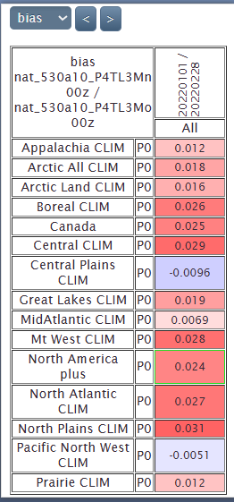
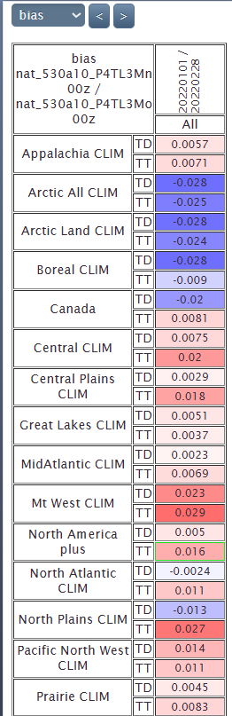
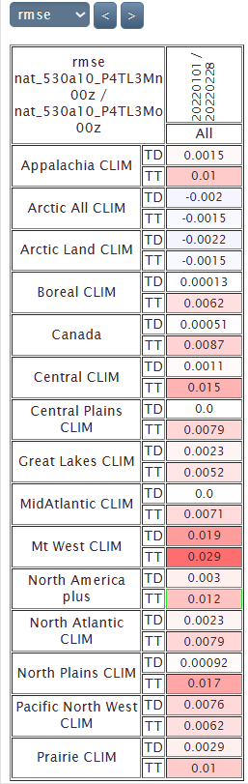
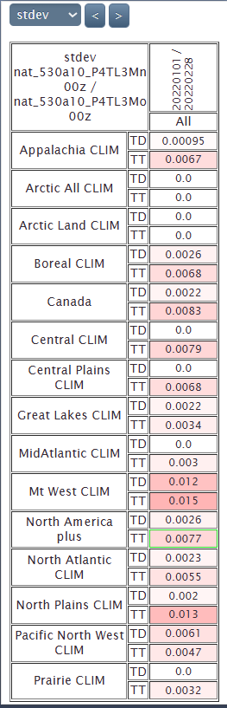
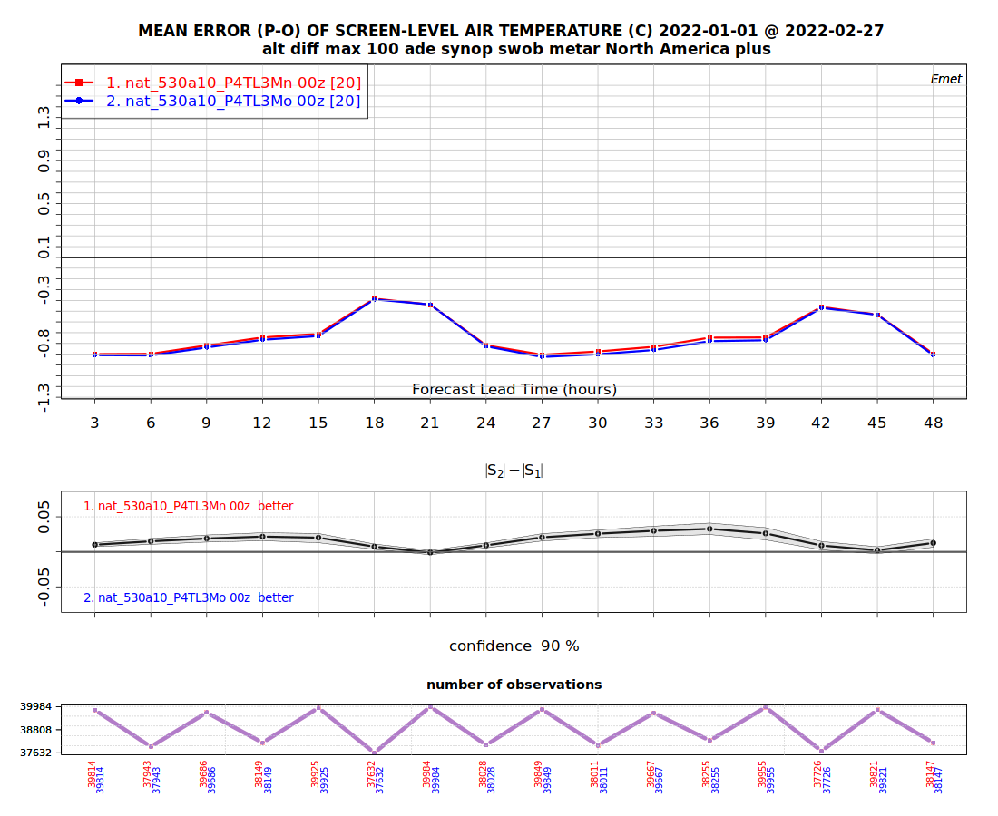
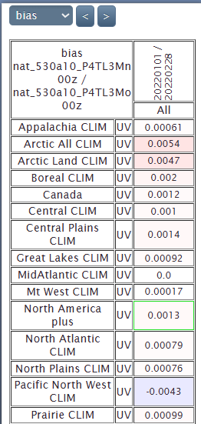
Scores v5.4.43Mo vs. 5.4.43Mn
Emet TT, TD, UV, P0
Very small differences

Slide 20
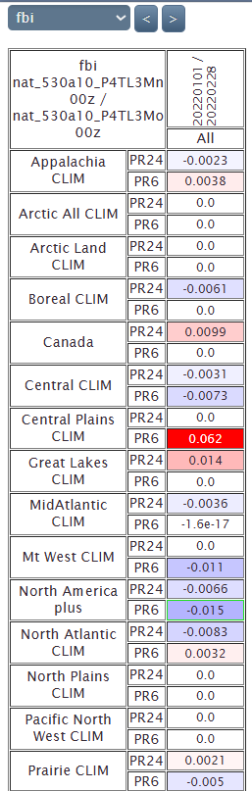
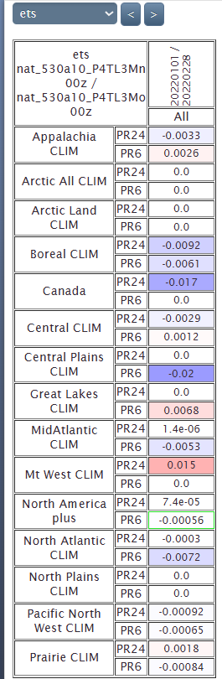
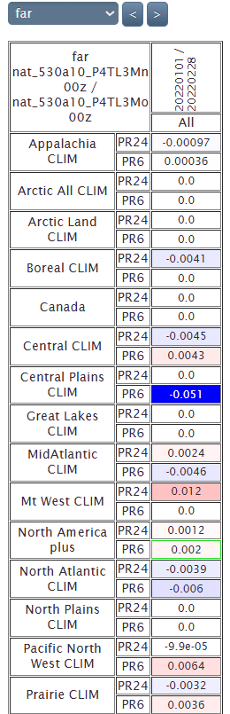
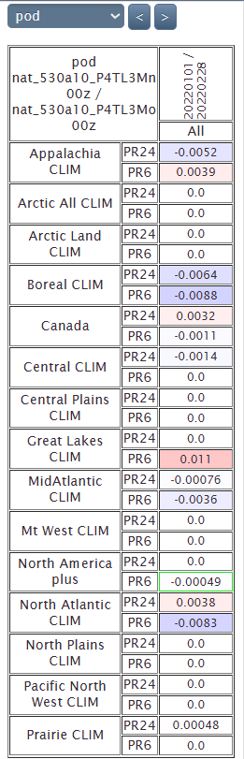
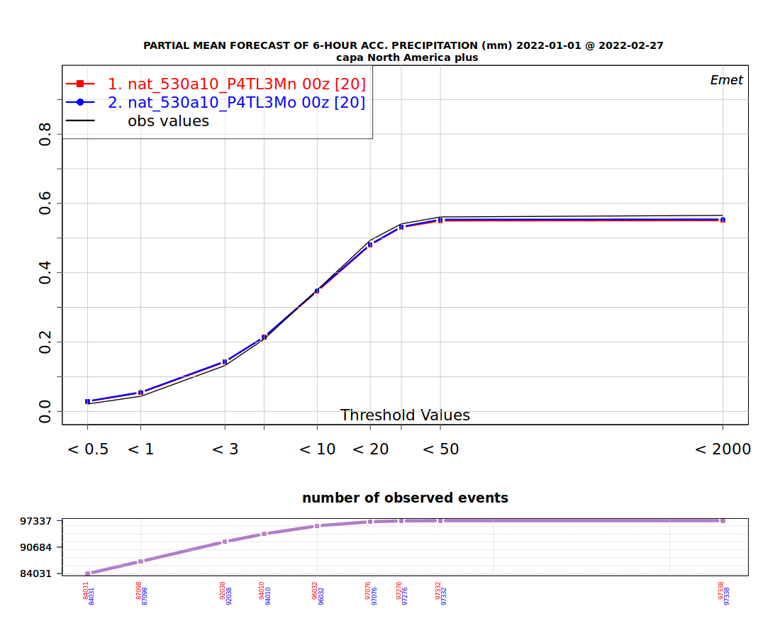
Scores v5.4.43Mo vs. v5.4.43Mn
Emet (PR6 and PR24)

Slide 21
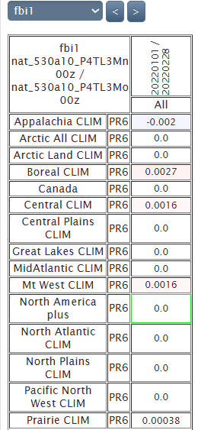
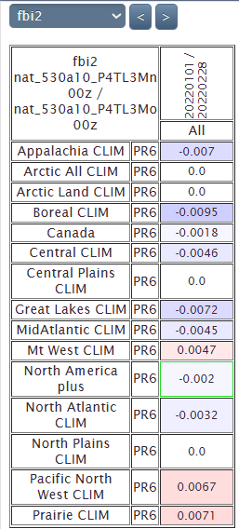
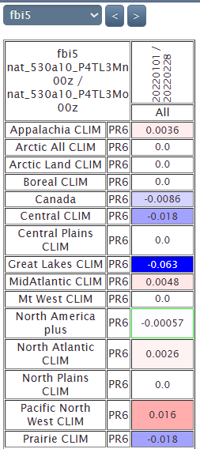
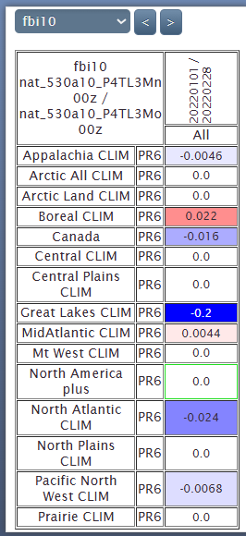
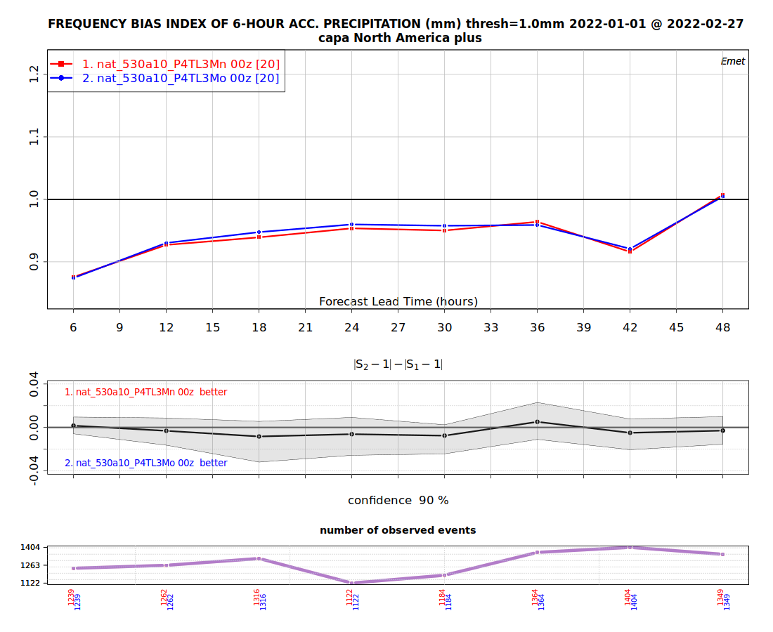
Scores v5.4.43Mo vs. v5.4.43Mn
FBI

Slide 22
Timing v5.4.4FL3Mo winter
HRnat_530a10_P4TL3Mo_2022010100_M_4595116.sc6pbs-001-ib.out.000:oe-00000-00000: Execution time : 7148.4058 seconds (14.52 ms logging)
HRnat_530a10_P4TL3Mo_2022010212_M_4595115.sc6pbs-001-ib.out.000:oe-00000-00000: Execution time : 7554.7858 seconds (14.12 ms logging)
HRnat_530a10_P4TL3Mo_2022010400_M_4595101.sc6pbs-001-ib.out.000:oe-00000-00000: Execution time : 7474.0948 seconds (14.38 ms logging)
HRnat_530a10_P4TL3Mo_2022010512_M_4595123.sc6pbs-001-ib.out.000:oe-00000-00000: Execution time : 7239.2990 seconds (14.37 ms logging)
HRnat_530a10_P4TL3Mo_2022010700_M_4595133.sc6pbs-001-ib.out.000:oe-00000-00000: Execution time : 7408.5748 seconds (14.01 ms logging)
HRnat_530a10_P4TL3Mo_2022010812_M_4595113.sc6pbs-001-ib.out.000:oe-00000-00000: Execution time : 7287.7729 seconds (14.57 ms logging)
HRnat_530a10_P4TL3Mo_2022011000_M_4595119.sc6pbs-001-ib.out.000:oe-00000-00000: Execution time : 7081.6171 seconds (13.68 ms logging)
HRnat_530a10_P4TL3Mo_2022011112_M_4595132.sc6pbs-001-ib.out.000:oe-00000-00000: Execution time : 7090.2209 seconds (14.30 ms logging)
HRnat_530a10_P4TL3Mo_2022011300_M_4595129.sc6pbs-001-ib.out.000:oe-00000-00000: Execution time : 7097.2246 seconds (14.80 ms logging)
HRnat_530a10_P4TL3Mo_2022011412_M_4595104.sc6pbs-001-ib.out.000:oe-00000-00000: Execution time : 7307.7766 seconds (14.20 ms logging)
HRnat_530a10_P4TL3Mo_2022011600_M_4595130.sc6pbs-001-ib.out.000:oe-00000-00000: Execution time : 7245.5846 seconds (14.62 ms logging)
HRnat_530a10_P4TL3Mo_2022011712_M_4595131.sc6pbs-001-ib.out.000:oe-00000-00000: Execution time : 7620.5671 seconds (14.02 ms logging)
HRnat_530a10_P4TL3Mo_2022011900_M_4595120.sc6pbs-001-ib.out.000:oe-00000-00000: Execution time : 7288.2555 seconds (14.28 ms logging)
HRnat_530a10_P4TL3Mo_2022012012_M_4595139.sc6pbs-001-ib.out.000:oe-00000-00000: Execution time : 7306.1197 seconds (14.34 ms logging)
HRnat_530a10_P4TL3Mo_2022012200_M_4595117.sc6pbs-001-ib.out.000:oe-00000-00000: Execution time : 7372.9733 seconds (14.08 ms logging)
HRnat_530a10_P4TL3Mo_2022012312_M_4595127.sc6pbs-001-ib.out.000:oe-00000-00000: Execution time : 6999.5063 seconds (14.11 ms logging)
HRnat_530a10_P4TL3Mo_2022012500_M_4595128.sc6pbs-001-ib.out.000:oe-00000-00000: Execution time : 6905.6225 seconds (14.04 ms logging)
HRnat_530a10_P4TL3Mo_2022012612_M_4595143.sc6pbs-001-ib.out.000:oe-00000-00000: Execution time : 7028.9002 seconds (14.46 ms logging)
HRnat_530a10_P4TL3Mo_2022012800_M_4595109.sc6pbs-001-ib.out.000:oe-00000-00000: Execution time : 7086.4850 seconds (14.08 ms logging)
HRnat_530a10_P4TL3Mo_2022012912_M_4595140.sc6pbs-001-ib.out.000:oe-00000-00000: Execution time : 7618.0720 seconds (14.16 ms logging)
HRnat_530a10_P4TL3Mo_2022013100_M_4596608.sc6pbs-001-ib.out.000:oe-00000-00000: Execution time : 6585.1411 seconds (14.57 ms logging)
HRnat_530a10_P4TL3Mo_2022020112_M_4596617.sc6pbs-001-ib.out.000:oe-00000-00000: Execution time : 7127.4772 seconds (14.13 ms logging)
HRnat_530a10_P4TL3Mo_2022020300_M_4596655.sc6pbs-001-ib.out.000:oe-00000-00000: Execution time : 7815.4916 seconds (13.75 ms logging)
HRnat_530a10_P4TL3Mo_2022020412_M_4596725.sc6pbs-001-ib.out.000:oe-00000-00000: Execution time : 7651.4572 seconds (14.49 ms logging)
HRnat_530a10_P4TL3Mo_2022020600_M_4596716.sc6pbs-001-ib.out.000:oe-00000-00000: Execution time : 7016.5964 seconds (14.42 ms logging)
HRnat_530a10_P4TL3Mo_2022020712_M_4596721.sc6pbs-001-ib.out.000:oe-00000-00000: Execution time : 7067.0652 seconds (14.63 ms logging)
HRnat_530a10_P4TL3Mo_2022020900_M_4596769.sc6pbs-001-ib.out.000:oe-00000-00000: Execution time : 7180.3536 seconds (14.16 ms logging)
HRnat_530a10_P4TL3Mo_2022021012_M_4596777.sc6pbs-001-ib.out.000:oe-00000-00000: Execution time : 6862.9438 seconds (14.03 ms logging)
HRnat_530a10_P4TL3Mo_2022021200_M_4596780.sc6pbs-001-ib.out.000:oe-00000-00000: Execution time : 6742.1085 seconds (13.99 ms logging)
HRnat_530a10_P4TL3Mo_2022021312_M_4596757.sc6pbs-001-ib.out.000:oe-00000-00000: Execution time : 7209.7034 seconds (14.35 ms logging)
HRnat_530a10_P4TL3Mo_2022021500_M_4596786.sc6pbs-001-ib.out.000:oe-00000-00000: Execution time : 7069.8136 seconds (14.64 ms logging)
HRnat_530a10_P4TL3Mo_2022021612_M_4596789.sc6pbs-001-ib.out.000:oe-00000-00000: Execution time : 7288.3498 seconds (14.19 ms logging)
HRnat_530a10_P4TL3Mo_2022021800_M_4596981.sc6pbs-001-ib.out.000:oe-00000-00000: Execution time : 7173.9019 seconds (14.30 ms logging)
HRnat_530a10_P4TL3Mo_2022021912_M_4597014.sc6pbs-001-ib.out.000:oe-00000-00000: Execution time : 6931.7529 seconds (13.88 ms logging)
HRnat_530a10_P4TL3Mo_2022022100_M_4597097.sc6pbs-001-ib.out.000:oe-00000-00000: Execution time : 7144.4794 seconds (14.08 ms logging)
HRnat_530a10_P4TL3Mo_2022022212_M_4597104.sc6pbs-001-ib.out.000:oe-00000-00000: Execution time : 7435.6391 seconds (13.98 ms logging)
HRnat_530a10_P4TL3Mo_2022022400_M_4597177.sc6pbs-001-ib.out.000:oe-00000-00000: Execution time : 7439.2120 seconds (14.20 ms logging)
HRnat_530a10_P4TL3Mo_2022022512_M_4597199.sc6pbs-001-ib.out.000:oe-00000-00000: Execution time : 7180.3399 seconds (14.23 ms logging)
HRnat_530a10_P4TL3Mo_2022022700_M_4597189.sc6pbs-001-ib.out.000:oe-00000-00000: Execution time : 6775.6857 seconds (14.03 ms logging)
HRnat_530a10_P4TL3Mo_2022022812_M_4597245.sc6pbs-001-ib.out.000:oe-00000-00000: Execution time : 6878.3068 seconds (14.67 ms logging)
Mean (3MOM_LF_n1):
280346/40 = 7008 seconds (+8%)
Total v5.4.43M (old) → increases the execution time by 28% compared to v5.4.4 2M.

Slide 23
Timing v5.4.4FL3Mn winter
HRnat_530a10_P4TL3Mn_2022010100_M_4602931.sc6pbs-001-ib.out.000:oe-00000-00000: Execution time : 7058.1541 seconds (14.26 ms logging)
HRnat_530a10_P4TL3Mn_2022010212_M_4602939.sc6pbs-001-ib.out.000:oe-00000-00000: Execution time : 7456.7969 seconds (14.24 ms logging)
HRnat_530a10_P4TL3Mn_2022010400_M_4602943.sc6pbs-001-ib.out.000:oe-00000-00000: Execution time : 7314.7077 seconds (14.07 ms logging)
HRnat_530a10_P4TL3Mn_2022010512_M_4602903.sc6pbs-001-ib.out.000:oe-00000-00000: Execution time : 7135.2665 seconds (14.02 ms logging)
HRnat_530a10_P4TL3Mn_2022010700_M_4602942.sc6pbs-001-ib.out.000:oe-00000-00000: Execution time : 7316.0871 seconds (14.11 ms logging)
HRnat_530a10_P4TL3Mn_2022010812_M_4602940.sc6pbs-001-ib.out.000:oe-00000-00000: Execution time : 7169.1103 seconds (14.49 ms logging)
HRnat_530a10_P4TL3Mn_2022011000_M_4602926.sc6pbs-001-ib.out.000:oe-00000-00000: Execution time : 7021.4778 seconds (14.51 ms logging)
HRnat_530a10_P4TL3Mn_2022011112_M_4602934.sc6pbs-001-ib.out.000:oe-00000-00000: Execution time : 7068.6240 seconds (14.73 ms logging)
HRnat_530a10_P4TL3Mn_2022011300_M_4602930.sc6pbs-001-ib.out.000:oe-00000-00000: Execution time : 7074.9188 seconds (14.03 ms logging)
HRnat_530a10_P4TL3Mn_2022011412_M_4602959.sc6pbs-001-ib.out.000:oe-00000-00000: Execution time : 7191.5786 seconds (13.88 ms logging)
HRnat_530a10_P4TL3Mn_2022011600_M_4602933.sc6pbs-001-ib.out.000:oe-00000-00000: Execution time : 7070.5293 seconds (14.00 ms logging)
HRnat_530a10_P4TL3Mn_2022011712_M_4602944.sc6pbs-001-ib.out.000:oe-00000-00000: Execution time : 7400.8579 seconds (14.36 ms logging)
HRnat_530a10_P4TL3Mn_2022011900_M_4602946.sc6pbs-001-ib.out.000:oe-00000-00000: Execution time : 7194.9563 seconds (14.24 ms logging)
HRnat_530a10_P4TL3Mn_2022012012_M_4602937.sc6pbs-001-ib.out.000:oe-00000-00000: Execution time : 7235.4903 seconds (14.37 ms logging)
HRnat_530a10_P4TL3Mn_2022012200_M_4602938.sc6pbs-001-ib.out.000:oe-00000-00000: Execution time : 7221.6917 seconds (14.34 ms logging)
HRnat_530a10_P4TL3Mn_2022012312_M_4602954.sc6pbs-001-ib.out.000:oe-00000-00000: Execution time : 6892.2516 seconds (14.37 ms logging)
HRnat_530a10_P4TL3Mn_2022012500_M_4602948.sc6pbs-001-ib.out.000:oe-00000-00000: Execution time : 6821.6850 seconds (14.13 ms logging)
HRnat_530a10_P4TL3Mn_2022012612_M_4602947.sc6pbs-001-ib.out.000:oe-00000-00000: Execution time : 6891.1959 seconds (14.33 ms logging)
HRnat_530a10_P4TL3Mn_2022012800_M_4602917.sc6pbs-001-ib.out.000:oe-00000-00000: Execution time : 7003.5534 seconds (14.33 ms logging)
HRnat_530a10_P4TL3Mn_2022012912_M_4602957.sc6pbs-001-ib.out.000:oe-00000-00000: Execution time : 7456.5820 seconds (14.21 ms logging)
HRnat_530a10_P4TL3Mn_2022013100_M_4604527.sc6pbs-001-ib.out.000:oe-00000-00000: Execution time : 6519.6978 seconds (14.17 ms logging)
HRnat_530a10_P4TL3Mn_2022020112_M_4604699.sc6pbs-001-ib.out.000:oe-00000-00000: Execution time : 7014.3034 seconds (14.33 ms logging)
HRnat_530a10_P4TL3Mn_2022020300_M_4604703.sc6pbs-001-ib.out.000:oe-00000-00000: Execution time : 7528.6914 seconds (14.19 ms logging)
HRnat_530a10_P4TL3Mn_2022020412_M_4604716.sc6pbs-001-ib.out.000:oe-00000-00000: Execution time : 7441.7661 seconds (14.09 ms logging)
HRnat_530a10_P4TL3Mn_2022020600_M_4604717.sc6pbs-001-ib.out.000:oe-00000-00000: Execution time : 6906.9812 seconds (14.55 ms logging)
HRnat_530a10_P4TL3Mn_2022020712_M_4604720.sc6pbs-001-ib.out.000:oe-00000-00000: Execution time : 6974.6839 seconds (14.64 ms logging)
HRnat_530a10_P4TL3Mn_2022020900_M_4604724.sc6pbs-001-ib.out.000:oe-00000-00000: Execution time : 7084.0798 seconds (14.39 ms logging)
HRnat_530a10_P4TL3Mn_2022021012_M_4604741.sc6pbs-001-ib.out.000:oe-00000-00000: Execution time : 6759.4794 seconds (14.24 ms logging)
HRnat_530a10_P4TL3Mn_2022021200_M_4604774.sc6pbs-001-ib.out.000:oe-00000-00000: Execution time : 6666.5935 seconds (14.48 ms logging)
HRnat_530a10_P4TL3Mn_2022021312_M_4604811.sc6pbs-001-ib.out.000:oe-00000-00000: Execution time : 7069.5425 seconds (13.94 ms logging)
HRnat_530a10_P4TL3Mn_2022021500_M_4605042.sc6pbs-001-ib.out.000:oe-00000-00000: Execution time : 6985.7388 seconds (13.92 ms logging)
HRnat_530a10_P4TL3Mn_2022021612_M_4605095.sc6pbs-001-ib.out.000:oe-00000-00000: Execution time : 7138.0171 seconds (14.21 ms logging)
HRnat_530a10_P4TL3Mn_2022021800_M_4605101.sc6pbs-001-ib.out.000:oe-00000-00000: Execution time : 7114.8915 seconds (14.42 ms logging)
HRnat_530a10_P4TL3Mn_2022021912_M_4605123.sc6pbs-001-ib.out.000:oe-00000-00000: Execution time : 6911.5194 seconds (14.55 ms logging)
HRnat_530a10_P4TL3Mn_2022022100_M_4605122.sc6pbs-001-ib.out.000:oe-00000-00000: Execution time : 7070.8045 seconds (14.07 ms logging)
HRnat_530a10_P4TL3Mn_2022022212_M_4605135.sc6pbs-001-ib.out.000:oe-00000-00000: Execution time : 7312.7871 seconds (14.51 ms logging)
HRnat_530a10_P4TL3Mn_2022022400_M_4605134.sc6pbs-001-ib.out.000:oe-00000-00000: Execution time : 7229.2395 seconds (14.48 ms logging)
HRnat_530a10_P4TL3Mn_2022022512_M_4605130.sc6pbs-001-ib.out.000:oe-00000-00000: Execution time : 7031.3242 seconds (13.90 ms logging)
HRnat_530a10_P4TL3Mn_2022022700_M_4605183.sc6pbs-001-ib.out.000:oe-00000-00000: Execution time : 6728.2010 seconds (14.01 ms logging)
HRnat_530a10_P4TL3Mn_2022022812_M_4605206.sc6pbs-001-ib.out.000:oe-00000-00000: Execution time : 6809.9626 seconds (14.23 ms logging)
Mean (3MOM_LF_n1):
283272/40 = 7081 seconds (+1%)
Total v5.4.43M (new) → increases the execution time by 29% compared to v5.4.4 2M.

Slide 24
Precipitation phase scores

Slide 25
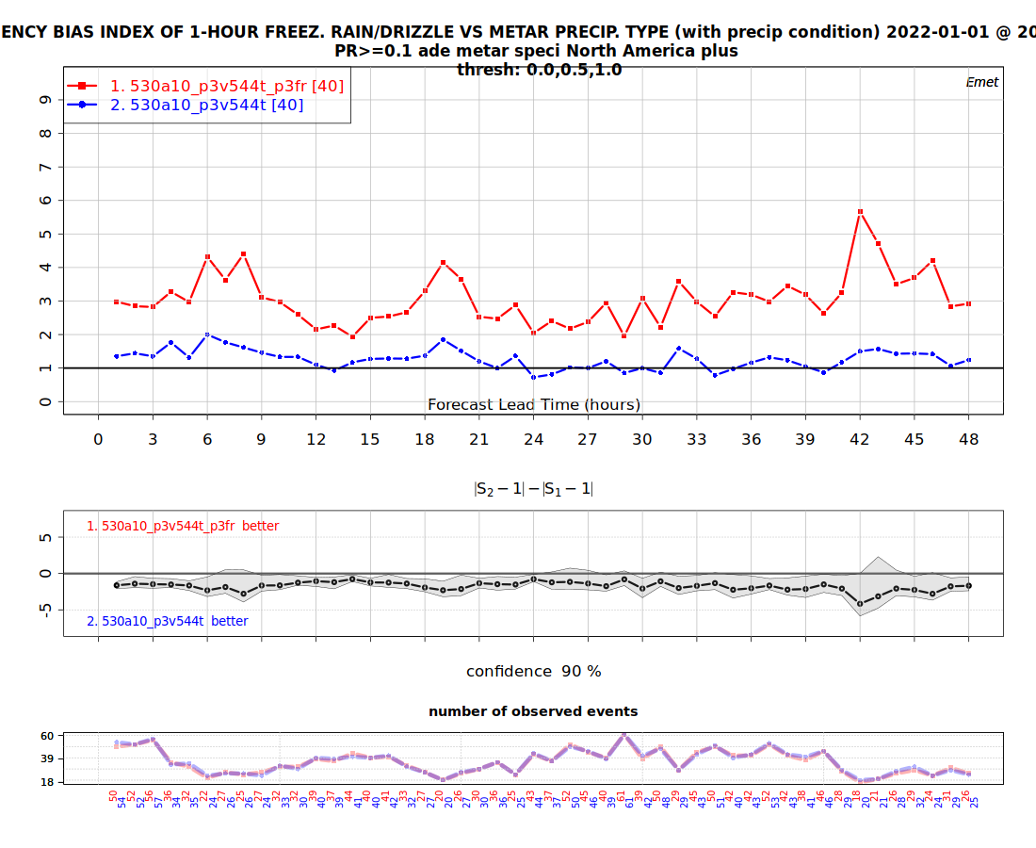

V5.4.4 FR FBI
P3
Bourgouin

Slide 26



V5.4.4 FR ETS, FAR, POD
P3
Bourgouin

Slide 27





V5.4.4 SN
P3
Bourgouin
PE

Slide 28




V5.4.4 RN
P3
Bourgouin

Slide 29
Conclusions
Neutrality is expected between v5.4.5 and v5.3.14 (HM changes) next tests.
Execution times of 3mom old and new increased significantly compared to 3mom old v5.3.14.

